Slide 1
Few-Shot Cross-Lingual Stance Detection with Sentiment-Based Pre-Training
Momchil Hardalov,^{1,2} Arnav Arora,^{1,3} Preslav Nakov,^{1,4} Isabelle Augenstein^{1,3}
¹Checkstep Research ²Sofia University "St. Kliment Ohridski" ³University of Copenhagen ⁴Qatar Computing Research Institute, HBKU
The Thirty-Sixth AAAI Conference on Artificial Intelligence (AAAI 2022)

Slide 2
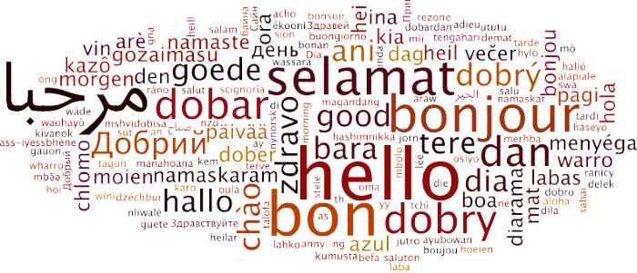
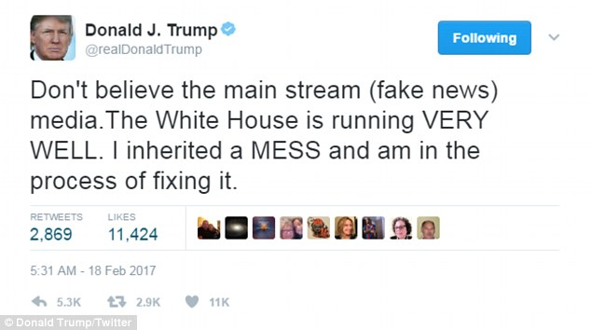
Stance Detection
“Classification of a writer’s viewpoint towards a target”
Notes:
Can be expressed by a person, an organization (UCB), a country (Turkey) etc

Slide 3
Stance Detection: Definitions
(Stance Detection) For an input in the form of a piece of text and a target pair, stance detection is a classification problem where the stance of the author of the text is sought in the form of a category label from this set: {Favor,Against,Neither}... ^{[1]}
(Stance Detection in Social Media) Stance Detection is concerned with individuals’ views toward objects of evaluation through various aspects related to the users’ post and personality traits.^{[2]} The category label is chosen from the set: {Support, Deny, Query, Comment}...^{[3]}
[1] Dilek Küçük and Fazli Can. 2020. Stance Detection: A Survey. ACM Comput. Surv. 53, 1, 12
[2] AlDayel, Abeer, and Walid Magdy. "Stance detection on social media: State of the art and trends." Information Processing & Management 58.4 (2021): 102597.
[3] Mohammad, Saif, et al. "Semeval-2016 task 6: Detecting stance in tweets." Proceedings of the 10th international workshop on semantic evaluation (SemEval-2016). 2016.

Slide 4
Motivation
Comprehensive Study of Cross-Lingual Stance Detection
Prior work: mostly narrow studies on small datasets
Combining multiple stance datasets was only recently explored for English

Slide 5
Motivation
Comprehensive Study of Cross-Lingual Stance Detection
Prior work: mostly narrow studies on small datasets
Combining multiple stance datasets was only recently explored for English
Improving Model Performance on Low-Resource Languages
Few-shot training with patterns
Learning from heterogeneous label definitions
Transfer from resource-rich languages, i.e., English

Slide 6
Motivation
Comprehensive Study of Cross-Lingual Stance Detection
Prior work: mostly narrow studies on small datasets
Combining multiple stance datasets was only recently explored for English
Improving Model Performance on Low-Resource Languages
Few-shot training with patterns
Learning from heterogeneous label definitions
Transfer from resource-rich languages, i.e., English
Obtaining More (Noisy) Training Data
Self-supervised labelling using sentiment analysis as a proxy
Multi-dataset learning in a cross-lingual few-shot setting

Slide 7
Contributions
Largest study of cross-lingual stance detection
Covering 15 datasets in 12 diverse languages from 6 language families

Slide 8
Contributions
Largest study of cross-lingual stance detection
Covering 15 datasets in 12 diverse languages from 6 language families
Exploring pattern-exploiting training (PET) for cross-lingual learning
Both in a few-shot and in a full-resource setting

Slide 9
Contributions
Largest study of cross-lingual stance detection
Covering 15 datasets in 12 diverse languages from 6 language families
Exploring pattern-exploiting training (PET) for cross-lingual learning
Both in a few-shot and in a full-resource setting
Novel label encoding mechanism
Eliminates the need for verbalisation in PET (single-token labels)

Slide 10
Contributions
Largest study of cross-lingual stance detection
Covering 15 datasets in 12 diverse languages from 6 language families
Exploring pattern-exploiting training (PET) for cross-lingual learning
Both in a few-shot and in a full-resource setting
Novel label encoding mechanism
Eliminates the need for verbalisation in PET (single-token labels)
Novel semi-supervised approach to produce automatically labelled instances
Based on a pre-trained model for sentiment analysis

Slide 11
Contributions
Largest study of cross-lingual stance detection
Covering 15 datasets in 12 diverse languages from 6 language families
Exploring pattern-exploiting training (PET) for cross-lingual learning
Both in a few-shot and in a full-resource setting
Novel label encoding mechanism
Eliminates the need for verbalisation in PET (single-token labels)
Novel semi-supervised approach to produce automatically labelled instances
Based on a pre-trained model for sentiment analysis
Promising results in a cross-lingual testbed
Sentiment-based pre-trained models show 6% F1 absolute gains over strong baselines
Our proposed approach outperforms fine-tuned XLM-R model on full-resource setting.

Slide 12
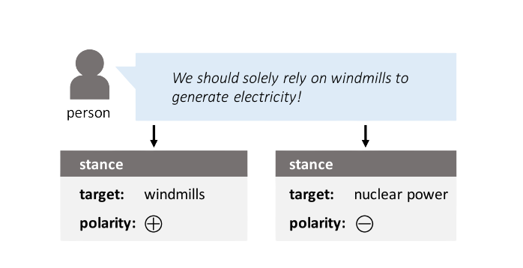
Sentiment vs. Stance
STANCE DETECTION
[1] https://expressanalytics.com/blog/social-media-sentiment-analysis/
[2] https://www.opend.org/en/dissertation/full/computer-assisted-understanding- of-stance-in-social-media-formalizations-data-creation-and-prediction-models

Slide 13
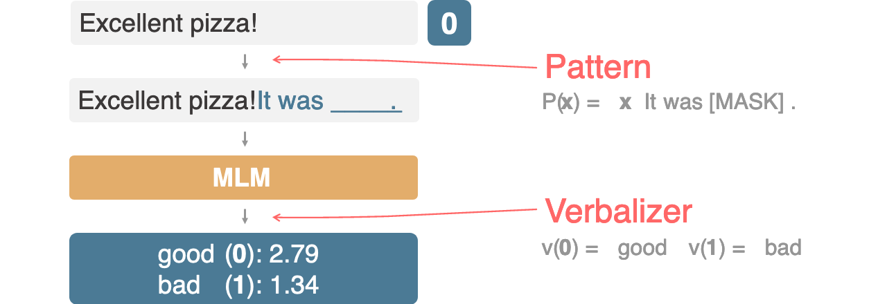
Pattern-Exploiting Training (PET)
http://www.timoschick.com/explanatory%20notes/2020/10/23/pattern-exploiting-training.html
https://aclanthology.org/2021.eacl-main.20.pdf

Slide 14
Pattern-Exploiting Training (PET)
Human engineered
http://www.timoschick.com/explanatory%20notes/2020/10/23/pattern-exploiting-training.html
https://aclanthology.org/2021.eacl-main.20.pdf

Slide 15
Pattern-Exploiting Training (PET)
Human engineered; Different performance
http://www.timoschick.com/explanatory%20notes/2020/10/23/pattern-exploiting-training.html
https://aclanthology.org/2021.eacl-main.20.pdf

Slide 16
Pattern-Exploiting Training (PET)
Human engineered; Different performance
Often single token
http://www.timoschick.com/explanatory%20notes/2020/10/23/pattern-exploiting-training.html
https://aclanthology.org/2021.eacl-main.20.pdf

Slide 17
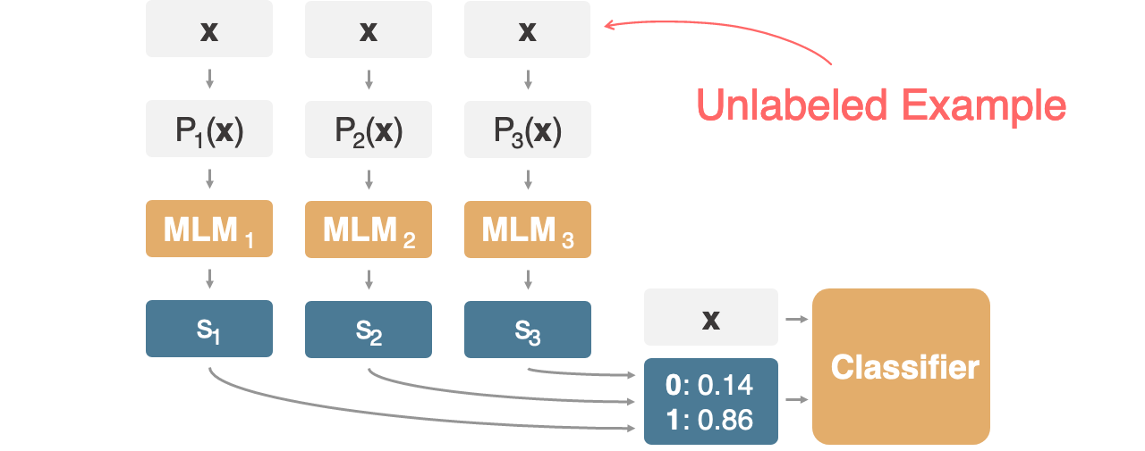
Pattern-Exploiting Training (PET)
http://www.timoschick.com/explanatory%20notes/2020/10/23/pattern-exploiting-training.html
https://aclanthology.org/2021.eacl-main.20.pdf

Slide 18
Pattern-Exploiting Training (PET)
*Not included in our work
http://www.timoschick.com/explanatory%20notes/2020/10/23/pattern-exploiting-training.html
https://aclanthology.org/2021.eacl-main.20.pdf

Slide 19
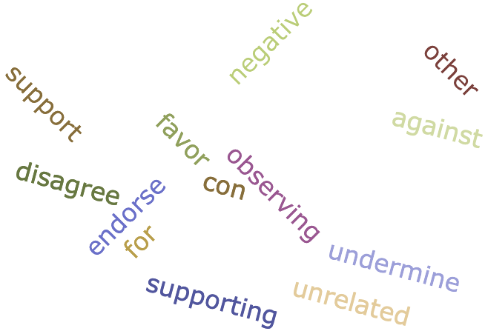
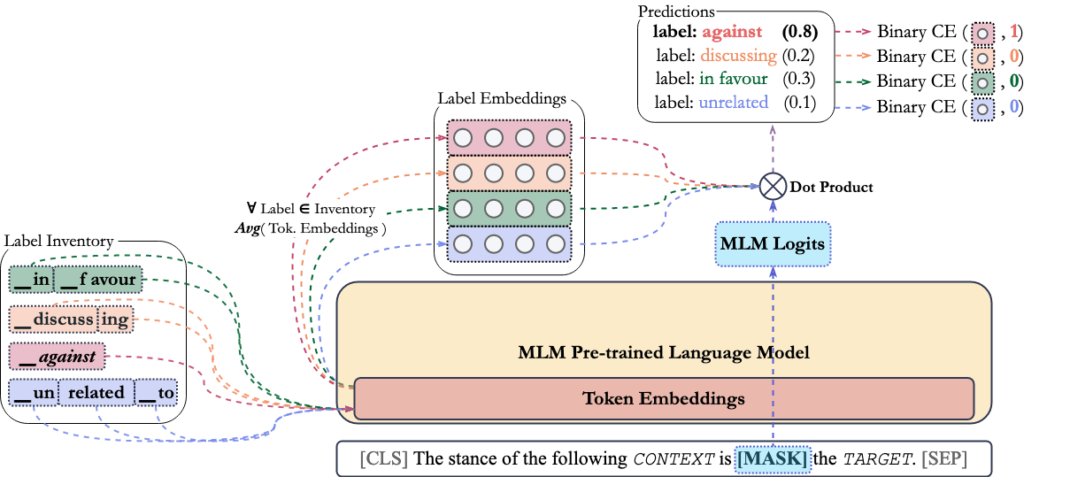
Our Approach
Positive/Negative Synonyms Samling
Key Characteristics
Pattern-Exploiting Training
Label encoder (no verbalisation)
Positive/Negative Label Sampling
Joint MLM + Label Loss

Slide 20
Our Approach
Positive/Negative Synonyms Samling
Key Characteristics
Pattern-Exploiting Training
Label encoder (no verbalisation)
Positive/Negative Label Sampling
Joint MLM + Label Loss

Slide 21
Our Approach
Positive/Negative Synonyms Samling
Key Characteristics
Pattern-Exploiting Training
Label encoder (no verbalisation)
Positive/Negative Label Sampling
Joint MLM + Label Loss

Slide 22
Our Approach
Positive/Negative Synonyms Samling
Key Characteristics
Pattern-Exploiting Training
Label encoder (no verbalisation)
Positive/Negative Label Sampling
Joint MLM + Label Loss

Slide 23
Our Approach
Positive/Negative Synonyms Sampling
Key Characteristics
Pattern-Exploiting Training
Label encoder (no verbalisation)
Positive/Negative Label Sampling
Joint MLM + Label Loss

Slide 24
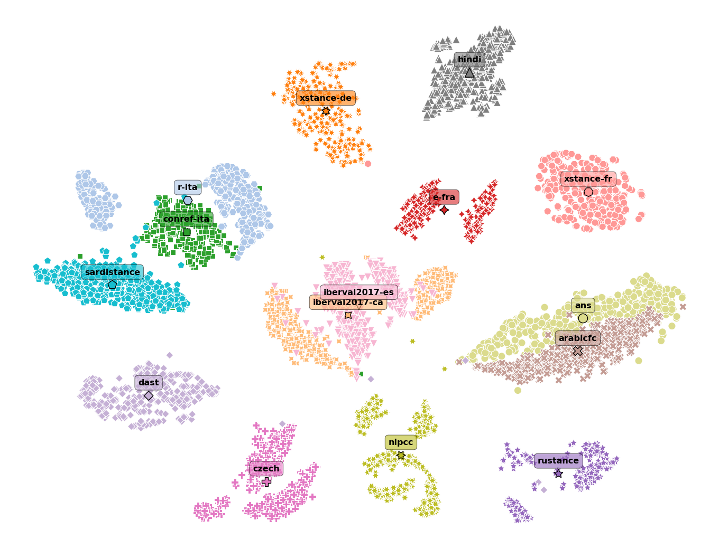
Cross-Lingual Testbed
Fifteen Diverse Datasets*
12 diverse languages
6 language families.
Over 30 Unique Labels
(Well-known) Favor, Against, etc.
(Additional) Neutral, etc.
(Unusual) Other, Question, etc.
Various Topics
Debates
Politics
Famous People
News
*Largest evaluation collection for cross-lingual stance detection, so far

Slide 25
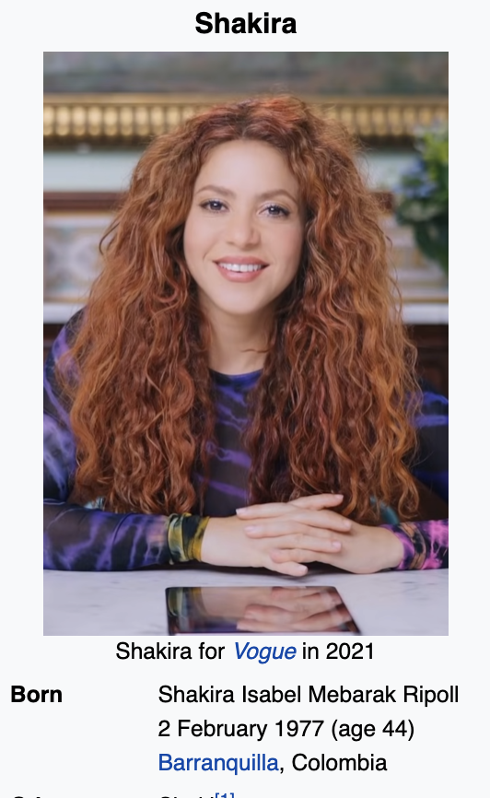
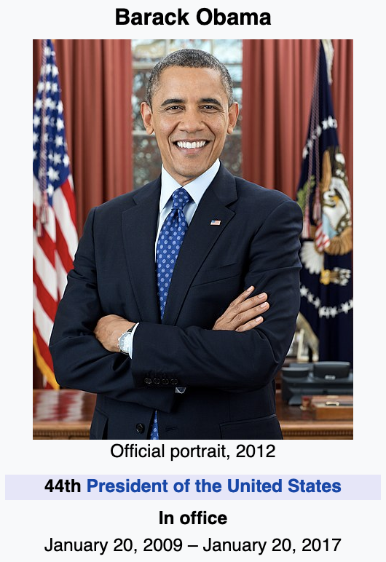
Sentiment-Based Stance Examples
Step I: Sample Candidate Articles
Step II: Match & Annotate
Step III: Augment (a) Expand Target
Barack Obama
Shakira (The Sun Comes Out World Tour)
Sentiment-Based Stance Datasets
Phoenix Suns
(b) Mix (Unrelated)
Phoenix Suns
Pre-trained Sentiment Classifier
Shakira (The Sun Comes Out World Tour)

Slide 26
Datasets (All)
Cross-Lingual Stance
100,000 examples (60K training)
Mostly small in size (most datasets have > 2K examples)

Slide 27
Datasets (All)
Cross-Lingual Stance
100,000 examples (60K training)
Mostly small in size (most datasets have > 2K examples)
Sentiment-Based Stance (en/mWiki)
Sampled from 12,000 Wiki articles
Multilingual: 1K per-language
English: All English
300,000 examples (8:1:1 split)

Slide 28
Datasets (All)
Cross-Lingual Stance
100,000 examples (60K training)
Mostly small in size (most datasets have > 2K examples)
Sentiment-Based Stance (en/mWiki)
Sampled from 12,000 Wiki articles
Multilingual: 1K per-language
English: All English
300,000 examples (8:1:1 split)
English Stance (enstance)
16 datasets, 250,000 examples (154K training)
24 unique labels

Slide 29
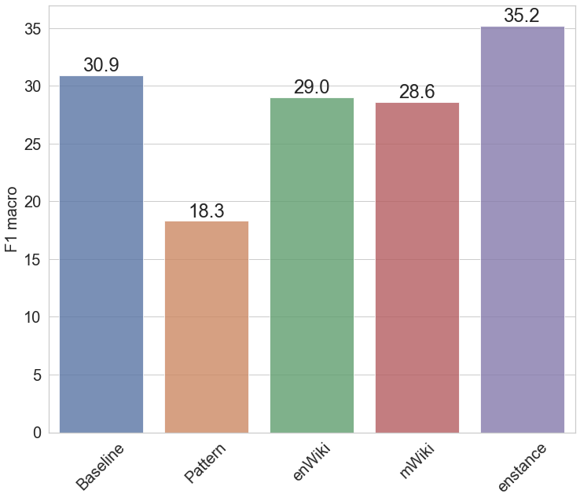
Zero-Shot Transfer
No cross-lingual (in-domain) training
Notes:
conref-ita, e-fra, nlpcc, r-ita, sardistance and xstance-fr

Slide 30
Zero-Shot Transfer
No cross-lingual (in-domain) training
Simple pattern without any pre-training does not know how to solve the task
Notes:
conref-ita, e-fra, nlpcc, r-ita, sardistance and xstance-fr

Slide 31
Zero-Shot Transfer
No cross-lingual (in-domain) training
Simple pattern without any pre-training does not know how to solve the task
Sentiment-based pre-trained models:
In general is worse than random
Promising results on some datasets
Best on "against, favor"
Notes:
conref-ita, e-fra, nlpcc, r-ita, sardistance and xstance-fr

Slide 32
Zero-Shot Transfer
No cross-lingual (in-domain) training
Simple pattern without any pre-training does not know how to solve the task
Sentiment-based pre-trained models:
In general is worse than random
Promising results on some datasets
Best on "against, favor"
English Stance pre-training (Best F1)
Beats the random baseline on 9/15
+5 F1 better than the baseline, -15 F1 worse than 32 examples
Still, does not guarantee successful transfer in zero-shot
Notes:
conref-ita, e-fra, nlpcc, r-ita, sardistance and xstance-fr

Slide 33
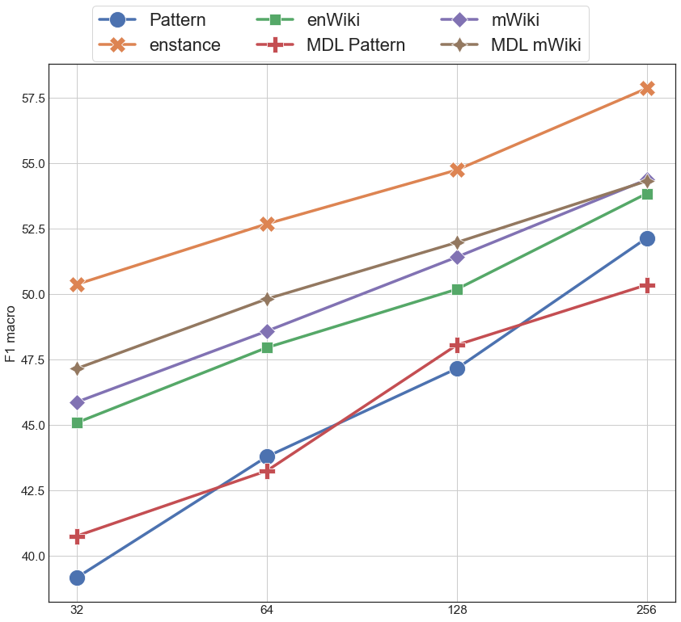
Few-Shot Training
Training on N-shots of cross-lingual (in-domain) data
All models outperform the random/zero-shot baseline

Slide 34
Few-Shot Training
Training on N-shots of cross-lingual (in-domain) data
All models outperform the random/zero-shot baseline
Models w/o any pre-training perform the worst

Slide 35
Few-Shot Training
Training on N-shots of cross-lingual (in-domain) data
All models outperform the random/zero-shot baseline
Models w/o any pre-training perform the worst
Multilingual Sentiment pre-training is better than the English Sentiment one

Slide 36
Few-Shot Training
Training on N-shots of cross-lingual (in-domain) data
All models outperform the random/zero-shot baseline
Models w/o any pre-training perform the worst
Multilingual Sentiment pre-training is better than the English Sentiment one
English stance adds 3-12 points F1 in few-shot setting compared to other models

Slide 37
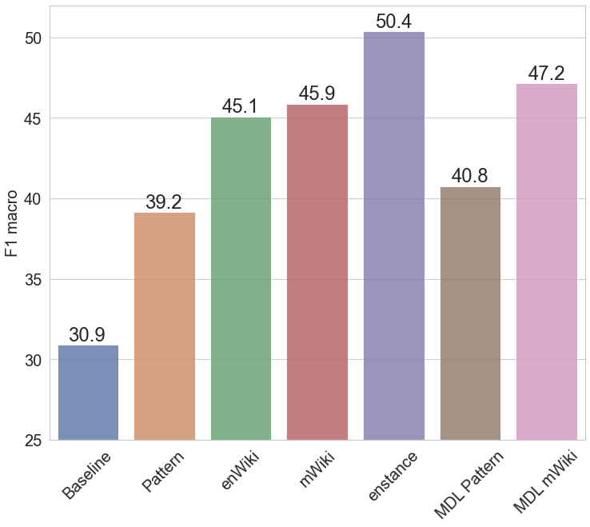
Discussion (Few-Shot)
Training on N-shots of cross-lingual (in-domain) data
Training on 32 examples leads to large variance and instability in the model
σ varies from 1.1 to 8.9, 3.5 on average
en/mWiki reduce avg. σ to 2.7
MDL drops σ to under 1.7

Slide 38
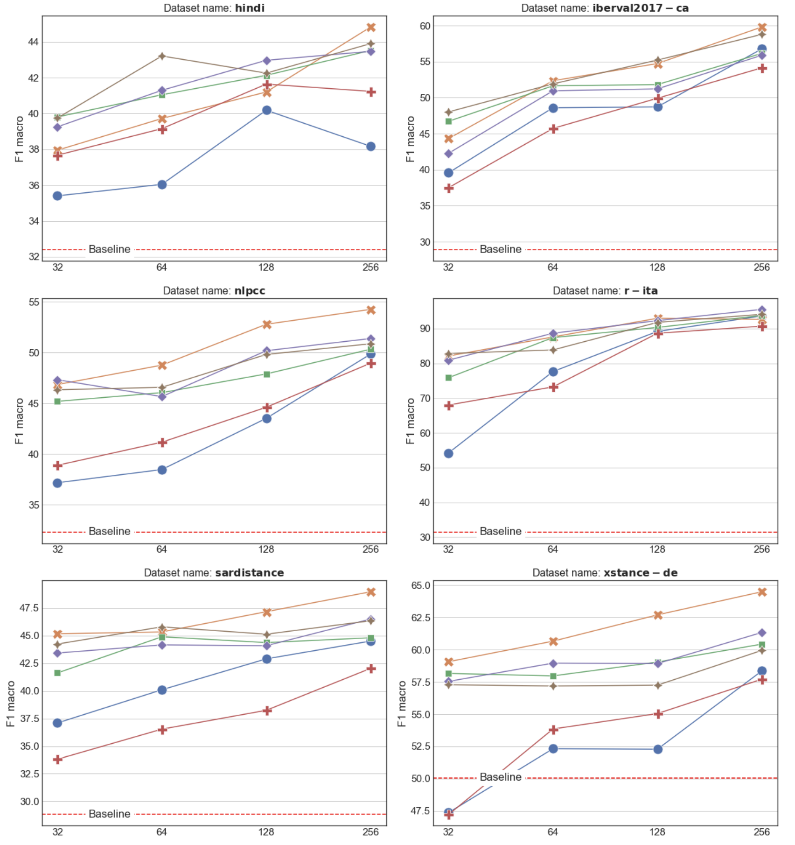
Discussion (Few-Shot)
Training on N-shots of cross-lingual (in-domain) data
Training on 32 examples leads to large variance and instability in the model
σ varies from 1.1 to 8.9, 3.5 on average
en/mWiki reduce avg. σ to 2.7
MDL drops σ to under 1.7
Per-dataset metrics follow the trends in the averaged F1 for most datasets

Slide 39
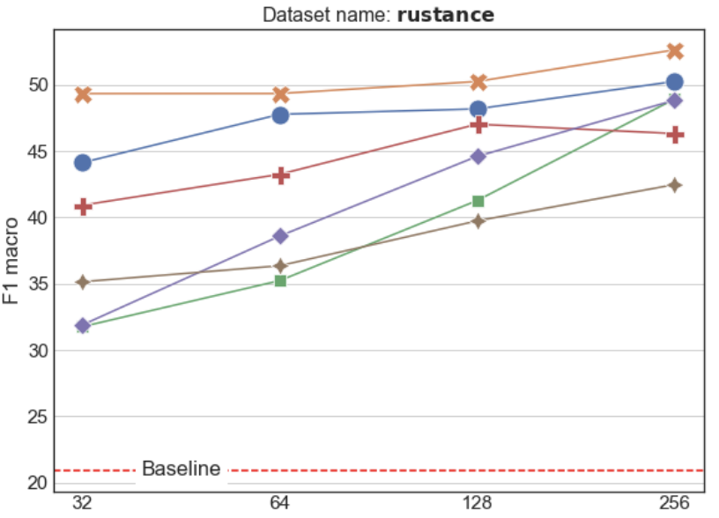
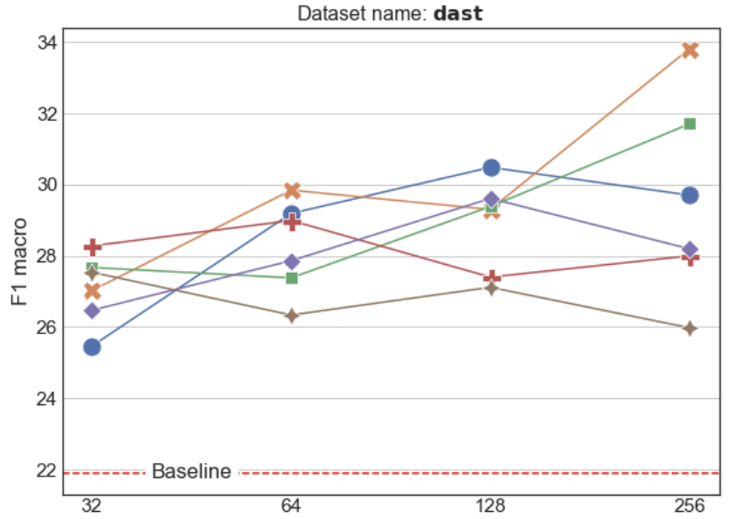
Discussion (Few-Shot)
Training on N-shots of cross-lingual (in-domain) data
Training on 32 examples leads to large variance and instability in the model
σ varies from 1.1 to 8.9, 3.5 on average
en/mWiki reduce avg. σ to 2.7
MDL drops σ to under 1.7
Per-dataset metrics follow the trends in the averaged F1 for most datasets
There is a risk of introducing additional bias with the pre-training

Slide 40
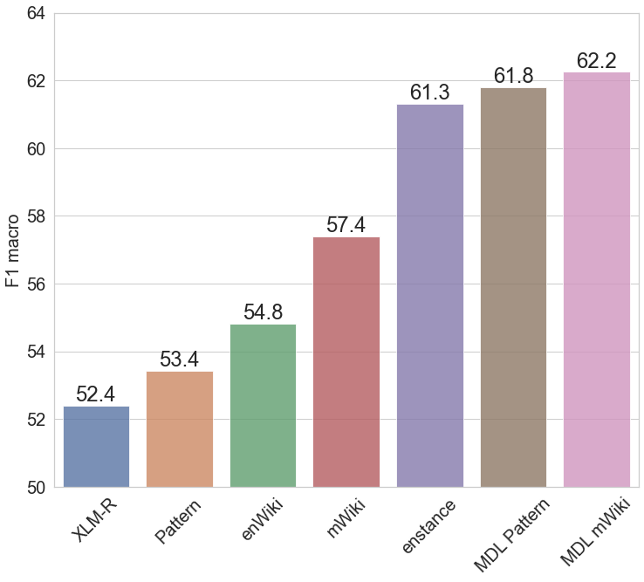
Full-Resource Training
Training on all data points from the cross-lingual (in-domain) datasets

Slide 41
Full-Resource Training
Training on all data points from the cross-lingual (in-domain) datasets
Pattern-based models outperform standard fine-tuned XLM-R

Slide 42
Full-Resource Training
Training on all data points from the cross-lingual (in-domain) datasets
Pattern-based models outperform standard fine-tuned XLM-R
Multilingual sentiment pre-training outperforms English

Slide 43
Full-Resource Training
Training on all data points from the cross-lingual (in-domain) datasets
Pattern-based models outperform standard fine-tuned XLM-R
Multilingual sentiment pre-training outperforms English
Stance-based pre-training is better than noisy sentiment

Slide 44
Full-Resource Training
Training on all data points from the cross-lingual (in-domain) datasets
Pattern-based models outperform standard fine-tuned XLM-R
Multilingual sentiment pre-training outperforms English
Stance-based pre-training is better than noisy sentiment
MDL on Multilingual/in-domain/ data outperforms English/out-of-domain/

Slide 45
Summary and Future Work
Summary
We presented the largest study on cross-lingual stance detection to date, covering 15 datasets
We investigated few-shot Pattern-Exploiting Training with different (pre-)training procedures
We proposed a novel label encoder that mitigates the need for verbalisation of labels
We introduced a novel methodology to produce artificial stance examples using a set of sentiment annotations
We offered a challenging testbed for cross-language evaluation

Slide 46
Summary and Future Work
Summary
We presented the largest study on cross-lingual stance detection to date, covering 15 datasets
We investigated few-shot Pattern-Exploiting Training with different (pre-)training procedures
We proposed a novel label encoder that mitigates the need for verbalisation of labels
We introduced a novel methodology to produce artificial stance examples using a set of sentiment annotations
We offered a challenging testbed for cross-language evaluation
Future Work
Experiment with more sentiment-based models and prompt-engineering techniques
Include other stance detection tasks, e.g., stance of a person/medium towards a claim/topic

Slide 47
Download our dataset, and train new models!
https://github.com/checkstep/senti-stance
If you have more questions, please contact momchil@checkstep.com

Slide 48
Thank You for Listening!
Please check out our paper for more details: “Few-Shot Cross-Lingual Stance Detection with Sentiment-Based Pre-Training”

Slide 49
Flash Slide
1 minute long presentation

Slide 50
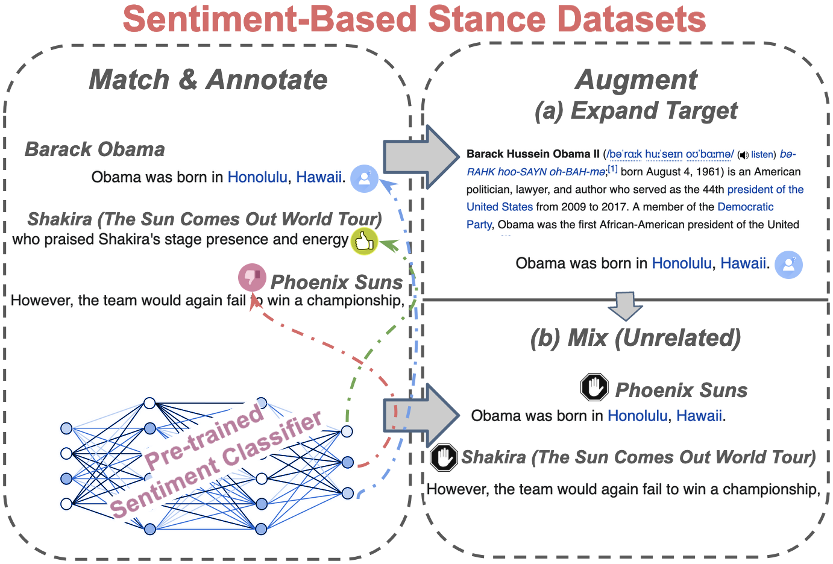
Few-Shot Cross-Lingual Stance Detection with Sentiment-Based Pre-Training
Momchil Hardalov, Arnav Arora, Preslav Nakov, Isabelle Augenstein

Slide 51
Sentiment-Based Stance Examples
Step I: Sample Candidate Articles
Match & Annotate
Step II: Match & Annotate
Augment (a) Expand Target
Step III: Augment (a) Expand Target
Sentiment-Based Stance Datasets
Barack Obama
Shakira (The Sun Comes Out World Tour)
Phoenix Suns
(b) Mix (Unrelated)
Phoenix Suns
Pre-trained Sentiment Classifier
Shakira (The Sun Comes Out World Tour)

Slide 52
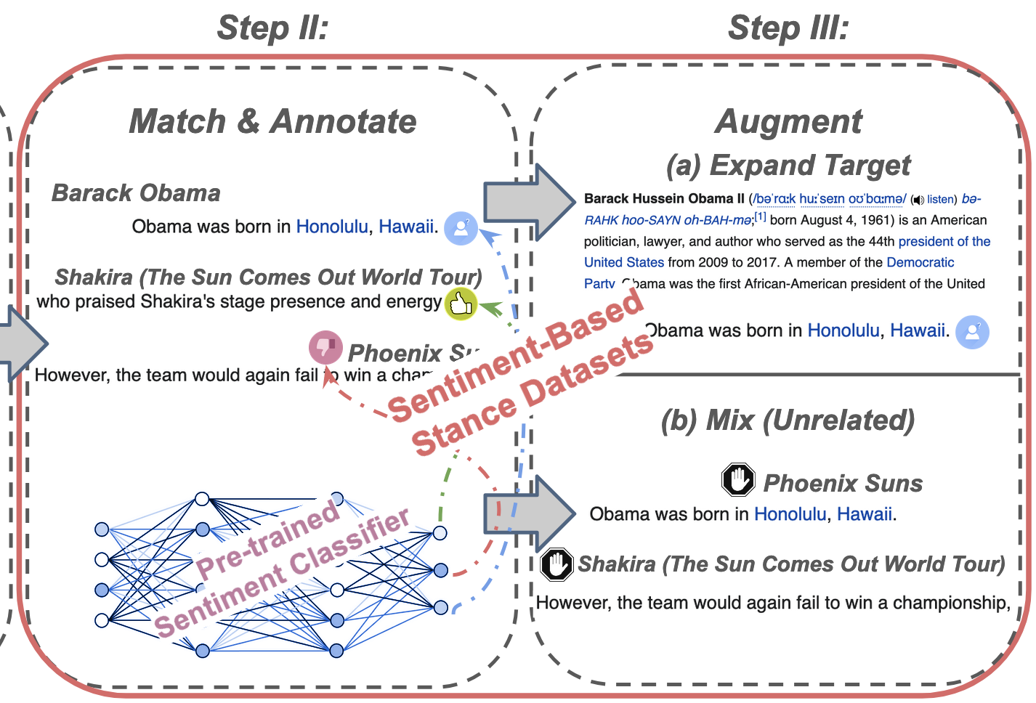

Slide 53
Momchil Hardalov,^{1,2} Arnav Arora,^{1,3} Preslav Nakov,^{1,4} Isabelle Augenstein^{1,3}
¹Checkstep Research ²Sofia University "St. Kliment Ohridski"
³University of Copenhagen
⁴Qatar Computing Research Institute, HBKU
The Thirty-Sixth AAAI Conference on Artificial Intelligence (AAAI 2022)

Slide 54
Our Approach
Positive/Negative Synonyms Sampling

Slide 55
Few-Shot Training
Training on N-shots of cross-lingual (in-domain) data
All models outperform the random/zero-shot baseline

